Slide 1
Operators

Slide 2
What Are Operators?
  Operators manipulate data and objects.
  Operators take one or more arguments and produce a value.
  There are 44 different operators.
  Some operators change the value of the operand.
Notes:
Operators in Java
Operators are used to manipulate the values that are stored in variables; these variables can be in expressions or they may contain literal values. Most programs that do anything do so by manipulating data. To calculate the due date of a video rental, the program must take the day that the video was rented and add some number of days. This is data manipulation. It is hard to imagine a program that does not use and manipulate data in some way, with the exception of raw queries of the database.
Java operators take one or more arguments, or operands, and produce a value. Java provides 44 different operators that manipulate data in one way or another. Some of those operators are more complex than others, and some are used more often.
This lesson focuses on the more important operators.
Note: It is not possible to extend the functionality of the operators. For example, in C++, you can define your own new meaning for the “–” operator; in Java, you cannot do this. However, the “+” sign in Java is actually the only overloaded operator in Java. It is used as both an arithmetic addition operator and also for String concatenation.

Slide 3
Categorizing Operators
There are five types of operators:
  Assignment
  Arithmetic
  Integer bitwise
  Relational
  Boolean
Notes:
Operators
Operators are special characters that are used to instruct the Java compiler to perform an operation on an operand. Java includes a set of 44 different operators. Most programs need only part of the 44 distinct operators.
Assignment Operators
Assignment operators set the value of a variable to a literal value or the value of another variable or expression.
Arithmetic Operators
Arithmetic operators perform mathematic computations on operands. Arithmetic operators operate on all numeric types.
Integer Bitwise Operators
Bitwise operators are provided to inspect and modify the internal bits that make up integer numeric types, whereas arithmetic operators modify the values of a variable as a whole unit.
Relational Operators
Relational operators compare two values. You can use relational comparison to set other values or to control program flow.
Boolean Logical Operators
Boolean operators can be used only on Boolean variables or expressions. The result of a Boolean operator is always a Boolean value.

Slide 4
Using the Assignment Operator
The result of an assignment operation is a value and can be used whenever an expression is permitted.
  The value on the right is assigned to the identifier on the left:
  The expression on the right is always evaluated before the assignment.
  Assignments can be strung together:
int var1 = 0, var2 = 0;
var1 = 50; // var1 now equals 50
var2 = var1 + 10; // var2 now equals 60
var1 = var2 = var3 = 50;
Notes:
Using the Assignment Operator
After a variable has been declared, you can assign a value by using the assignment operator. First, the value of the expression on the right side of the assignment operator is determined or evaluated, and then the result is assigned to the variable on the left.
Note the following example:
var1 = 10;
var2 = var1 + 10; // the right side is evaluated first
var2 now equals 20.
Assignments Can Be Strung Together in the Same Statement
Multiple assignment operators can be used within a single statement as follows:
var1 = var2 = var3 = 50;
The assignment operator has “right associativity,” which means that the rightmost assignment operator is performed first in this statement. The other assignments are evaluated moving from the right to the left. The statement can be rewritten as follows, to emphasize the order in which the assignments are carried out and to make the code clearer:
var1 = (var2 = (var3 = 50));
The net result is that the value 50 is assigned to all three variables.

Slide 5
Working with Arithmetic Operators
  Perform basic arithmetic operations.
  Work on numeric variables and literals.
int a, b, c, d, e;
a = 2 + 2; // addition
b = a * 3; // multiplication
c = b - 2; // subtraction
d = b / 2; // division
e = b % 2; // returns the remainder of division
Notes:
Simple Arithmetic Operators
Most of the arithmetic operators in Java are similar to those in other languages. Both operands must be of numeric types and the result of the operation is always numeric. The important things to remember when using the simple arithmetic operators are:
Integer division results in an integer, and any remainder is ignored.
The multiply, divide, and modulus operators have higher precedence than the add and subtract operators. In other words, multiplication, division, and modulus operations are evaluated before addition and subtraction operations.
Arithmetic operations can be performed on variables and literals.
Modulus (mod) returns the remainder of a division operation.

Slide 6
More on Arithmetic Operators
Most operations result in int or long:
  byte, char, and short values are promoted to int before the operation.
  If either argument is of the long type, then the other is also promoted to long, and the result is of the long type.
byte b1 = 1, b2 = 2, b3;
b3 = b1 + b2; // ERROR: result is an int
// b3 is byte
Notes:
Integer Arithmetic in Java Is Always Performed by Using int or long
In Java, all integer arithmetic is performed with int or long values; byte, char, and short values are automatically widened (promoted) to int before an arithmetic operation commences, and the result is also int. Similarly, if the argument on one side of an arithmetic operator is a long, then the argument on the other side is automatically promoted to a long as well, and the result is a long.
Consequently, if the result is to be assigned to a variable of a smaller type, then the compiler signals an error.
Promoting floats
If an expression contains a float, the entire expression is promoted to float. All literal floating-point values are viewed as doubles.

Slide 7
Using the Arithmetic Assignment Operators
  Arithmetic Assignment Operators
    Addition(+), subtraction(-), multiplication(*), division(/), and modulo(%) are the arithmetic operators supported by Java.
    Various arithmetic operators, such as +, -, /, *, and % are combined with the assignment operator (=) and are called arithmetic assignment operators.

Slide 8
Using the Arithmetic Assignment
Operators (Contd.)
Operator
Use
Description
+=
op1 += op2
Adds operand, op1 and operand, op2 and assigns the result to op1. This expression is equivalent to op1 = op1+op2.
- =
op1 -= op2
Subtracts operand, op2 from operand, op1 and assigns the result to op1. This expression is equivalent to op1 = op1 – op2.

Slide 9
Using the Arithmetic Assignment
Operators (Contd.)
Operator
Use
Description
*=
op1 *= op2
Multiplies operand, op1 and operand, op2 and assigns value of the result to op1. This expression is equivalent to op1 = op1*op2.
/=
op1 /= op2
Divides operand, op1 by operand, op2, and assign the value of the result to op1. This expression is equivalent to op1 = op1/op2.

Slide 10
Using the Arithmetic Assignment
Operators (Contd.)
Operator
Use
Description
%=
op1 %= op2
Assigns the remainder of division of operand, op1 and operand, op2 to op1. This expression is equivalent to op1 = op1% op2.

Slide 11
Using Bit-wise Operators
  Bit-wise operators
    Operate on the individual bits of their operand.
    Operands can be various data types like int, short, long, char, and byte.
    Operands are converted into their binary equivalents before operation.
    The result in the binary form after the operation is converted back into its decimal equivalent.

Slide 12
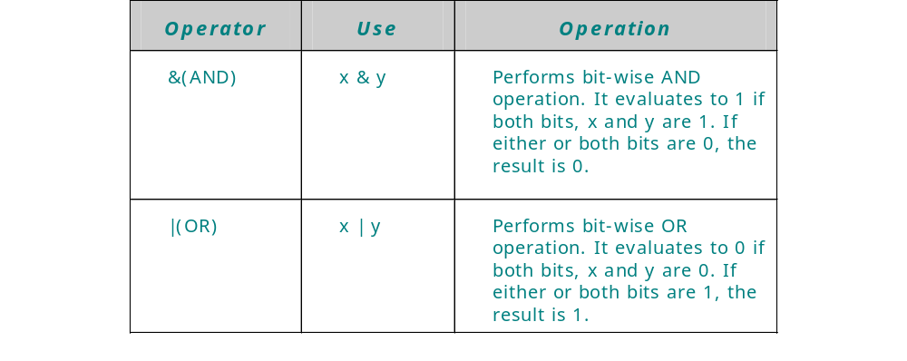
Using Bit-wise Operators(Contd.)
  The following table lists the various bit-wise operators in Java:

Slide 13
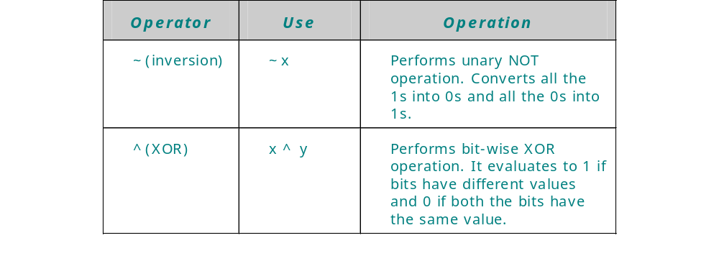
Using Bit-wise Operators(Contd.)

Slide 14

Using Bit-wise Operators (Contd.)
Using the Bit-wise AND Operator
  The Bit-wise AND operator (&) performs AND operation on two operands.
  Displays 1 if both bits are 1 else 0 in all other cases.

Slide 15

Using Bit-wise Operators (Contd.)
Using the Bit-wise OR Operator
  The Bit-wise OR operator (|) performs OR operation on two operands.
  Displays 0 if both bits are 0 else 1 in all other cases.

Slide 16

Using Bit-wise Operators (Contd.)
Using the Bit-wise NOT Operator
  Bit-wise NOT operator (~) is a unary operator and performs NOT operation on each bit of binary number.
  The NOT operator inverts or complements each of the bits of a binary number.

Slide 17

Using Bit-wise Operators (Contd.)
Using the Bit-wise XOR Operator
  The Bit-wise XOR (^) operator performs XOR operation on two operands.
  The XOR operator applied on two bits results in 1 if exactly one bit is 1 else 0 in all other cases .

Slide 18
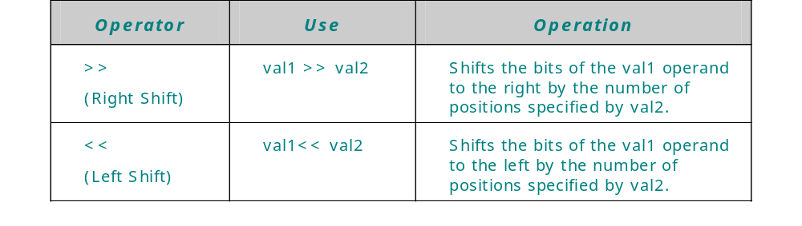
Using Shift Operators
  Works on the bits of data.
  Shifts the bits of it’s operand either to left or right.

Slide 19
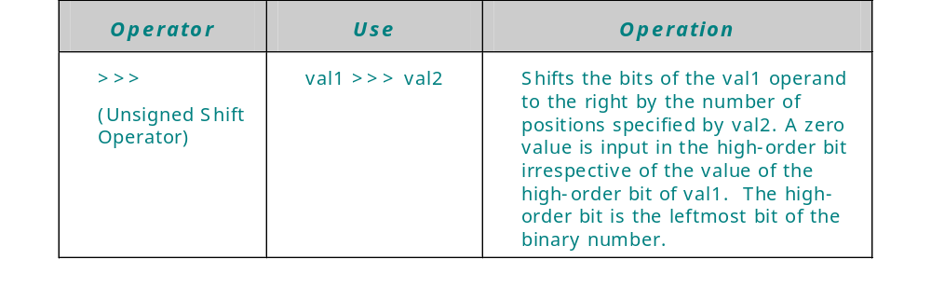
Using Shift Operators (Contd.)

Slide 20
Using Shift Operators (Contd.)
Using the Right Shift and Left Shift Operators
  The right shift and the left shift operators are binary operators.
    The right shift operator shifts all the bits of a binary number in the right direction.
      operand >> num
    The left shift operator, <<, shifts all the bits of a binary number in the left direction.
      operand << num
Using the Unsigned Shift Operator
  Unsigned shift operator (>>>) is used to shift the bits of a binary number to the right.
  The operator fills the leftmost bits of a binary value with 0 irrespective of whether the number has 0 or 1 at the leftmost bit.

Slide 21
Using instance of Operator
  Used to test whether an object is an instance of a specific class.
  Used at the run time.
  The syntax of the instanceof operator is:
  op1 instanceof op2
  op1 is the name of an object and op2 is the name of a class.
  Returns a true value if the op1 object is an instance of the op2 class.

Slide 22
Example
public class instanceofOperator {
public static void main(String[] args) {
// Create String object instance
String str1 = "Life is worth living... with Passion!";
Integer int1 = new Integer(40);
// Check if str1 is String type using instanceof operator.
// Check also if it is Object type.
boolean b1 = str1 instanceof String;
System.out.println("str1 is String type: " + b1);
boolean b2 = str1 instanceof Object;
System.out.println("str1 is Object type: " + b2);
// Check if int1 is Integer type using instanceof operator.
// Check also if it is Object type.
b1 = int1 instanceof Integer;
System.out.println("int1 is Integer type: " + b1);
b2 = int1 instanceof Object;
System.out.println("int1 is Object type: " + b2);
b2 = int1 instanceof Number;
System.out.println("int1 is Number type: " + b2);
}
}

Slide 23
Incrementing and Decrementing Values
  The ++ and -- operators increment and decrement by 1, respectively:
  The ++ and -- operators can be used in two ways:
int var1 = 3;
var1++; // var1 now equals 4
int var1 = 3, var2 = 0;
var2 = ++var1; // Prefix: Increment var1 first,
// then assign to var2.
var2 = var1++; // Postfix: Assign to var2 first,
// then increment var1.
Notes:
Increment and Decrement Operators
Incrementing or decrementing a value by one is a very common operation in any language. Like C and C++, Java provides special operators for this purpose. Both the increment (++) and decrement (--) operators can be prefixed or postfixed; that is, they can be placed before or after the operand. The placement of the operators affects when the operation takes place.
Prefixed Operator
When an increment or decrement operator is placed in front of a variable, the variable is incremented before any assignment operation. In other words, the value in the variable is adjusted by 1 (either up or down), and then it is used in the assignment.
Postfixed Operator
When the operator is placed after the variable, the variable is adjusted after the assignment operation. The value that is assigned is the value of the variable before it is incremented or decremented.
Instructor Note
Many students find these operators confusing. Make sure that they understand the difference between prefix and postfix.

Slide 24
Relational and Equality Operators
>
>=
<
<=
==
!=
greater than
greater than or equal to
less than
less than or equal to
equal to
not equal to
int var1 = 7, var2 = 13;
boolean res = true;
res = (var1 == var2); // res now equals false
res = (var2 > var1); // res now equals true
Notes:
Relational and Equality Operators
Java provides a set of relational and equality operators for comparing the values of two variables or expressions. Unlike many languages, other than C and C++, the equality operator is a double equals sign, ==. The inequality operator is !=.
Remember that the assignment operator, the equals sign, sets the value of the variable on the left of the sign to the value of the expression or variable on the right side of the equals sign. The double equals sign tests for equality of both sides. For example:
int goodCreditRating = 3;
boolean goodCredit = false;
goodCredit = (custRating == goodCreditRating);
In the example, if the customers rating is not 3, then goodCredit will be assigned false, which is the result of comparing the value of goodCreditRating with the customer’s actual rating. If the actual rating was 3, then the result will be true.
Instructor Note
Many students mix up the assignment operator and the equality operator. Emphasize the difference between the two.

Slide 25
Using the Conditional Operator (?:)
  Useful alternative to if…else:
  If boolean_expr is true, the result is expr1; otherwise, the result is expr2:
boolean_expr ? expr1 : expr2
int val1 = 120, val2 = 0;
int highest;
highest = (val1 > val2) ? val1 : val2;
System.out.println("Highest value is " + highest);
Notes:
The Conditional Operator (?:)
The conditional operator (?:) is the only ternary operator in Java, which means it has three operands. The conditional operator is an expression that returns a value and is a useful alternative to if…else.
The Boolean expression evaluates first and, if true, returns the value of the first expression (expr1) or if false, returns the value of the second expression (expr2).
For example, consider the conditional operator:
max = (10 > 8) ? 100: 200;
Because 10 is greater than 8, max is set to 100. The values of the expressions (100 and 200) can be any valid Java expressions including literals.
A similar effect can be achieved by using an if…else statement, as follows. Use whichever approach you find more intuitive.
if (10 > 8)
max = 100;
else
max = 200;

Slide 26
Using Logical Operators
Results of Boolean expressions can be combined by using logical operators:
&& &
|| |
^
!
and (with or without short-circuit evaluation)
or (with or without short-circuit evaluation)
exclusive or
not
int var0 = 0, var1 = 1, var2 = 2;
boolean res = true;
highest = (val1 > val2)? val1 : val2;
res = !res;
Notes:
Logical Operators
Boolean values and expressions that result in Boolean values can be combined by using the logical operators &, |, and !, which represent AND, OR, and NOT operations, respectively.
Short-Circuit Evaluation
The && and ||operators provide support for “short-circuit evaluation”; if the expression on the left of the operator has already determined the outcome of the whole logical expression, then the expression on the right of the operator is not performed.
Consider the following example using the && operator:
if (test1() && test2())
If test1 returns false, then there is no need to carry out test2 because a logical AND requires both tests to yield true; therefore, test2 is not performed.
Likewise, consider the following example using the || operator:
if (test1() || test1())
If test1 returns true, there is no need to carry out test2 because a logical OR only requires one of the tests to yield true; therefore, test2 is not performed.
Non-Short-Circuit Evaluation
If you have a Boolean expression involving two tests and you want the second test to be performed regardless of the outcome of the first test, use the & operator instead of &&, and the | operator instead of ||. Also, note that there is a ^ operator that performs the exclusive OR operation.

Slide 27
Compound Assignment Operators
An assignment operator can be combined with any conventional binary operator:
double total=0, num = 1;
double percentage = .50;
…
total = total + num; // total is now 1
total += num; // total is now 2
total -= num; // total is now 1
total *= percentage; // total is now .5
total /= 2; // total is now 0.25
num %= percentage; // num is now 0
Notes:
Compound Assignment Operators
Expressions such as var1 = var1 + 20 are so common that Java provides compound assignment operators as a shorthand equivalent. You can form these compound operators by combining the assignment operator with any of the conventional binary operators. Binary operators are those operators that use two arguments such as +, -, *, / and so on.
For example, the expression
rentalDueDate = rentalDueDate + 3;
can be rewritten as follows:
rentalDueDate += 3;
This expression takes the current value of rentalDueDate and adds 3. It then places the result into rentalDueDate.
The %= operator computes the remainder of dividing the first variable by the second, and then assigns it to the first variable.

Slide 28
Operator Precedence
Order
1
2
3
4
5
6
7
8
9
10
11
12
13
Operators
++ -- + - ~
! (type)
* / %
+ - +
<< >> >>>
< > <= >=
instanceof
== !=
&
^
|
&&
||
?:
= op=
Comments
Unary operators
Multiply, divide, remainder
Add, subtract, add string
Shift (>>> is zero-fill shift)
Relational, type compare
Equality
Bit/logical AND
Bit/logical exclusive OR
Bit/logical inclusive OR
Logical AND
Logical OR
Conditional operator
Assignment operators
Assoc.
R
L
L
L
L
L
L
L
L
L
L
R
R
Notes:
Java Operators
Precedence refers to the order in which operators are executed. For example, multiplication is always performed before addition or subtraction. The table in the slide shows the Java operators in order of precedence, where row 1 has the highest precedence. With the exception of the unary, conditional, and assignment operators, which are right associative, operators with the same precedence are executed from left to right.
Associativity
Operators with the same precedence are performed in order, according to their associativity. In the slide, the final column in the table shows the associativity for each operator:
L indicates left-to-right associativity. Most operators fall in this category.
R indicates right-to-left associativity. Only the unary operators (row 1), the conditional operator (row 12), and the assignment operators (row 13) fall in this category.
For example, consider the following statement:
int j = 3 * 10 % 7;
The * and % operators have the same precedence, but have left-to-right associativity. Therefore, the * is performed first, as though you had used parentheses as follows:
int j = (3 * 10) % 7; // Same result, 30%7, which is 2
If you choose to place parentheses in a different place, then you get a different result:
int j = 3 * (10 % 7);// Different result, 3*3, which is 9

Slide 29
More on Operator Precedence
  Operator precedence determines the order in which operators are executed:
  Operators with the same precedence are executed from left to right (see note in text below):
  Use parentheses to override the default order.
int var1 = 0;
var1 = 2 + 3 * 4; // var1 now equals 14
int var1 = 0;
var1 = 12 - 6 + 3; // var1 now equals 9
Notes:
Using the Precedence Table
The precedence table defines the order in which operators are evaluated. If you have a complex expression containing many operators, then refer to the precedence table to make sure that the operators are being performed in the order that you expect.
To make things simpler, you can use parentheses to override the default order in which operators are executed. Many programmers also use parentheses where they are not strictly necessary to make the code more readable.
Note: The second bullet in the slide states that operators with the same precedence are evaluated from left to right. This is true for all operators except the unary operators, the conditional operator, and the assignment operators, which are evaluated from right to left as described on the previous page.
Using Parentheses
Use parentheses to control the order of statement evaluation exactly. Consider the following variations:
var1 = 12 - 6 + 3; // var1 now equals 9
var1 = 12 - (6 + 3); // var1 now equals 3

Slide 30
Concatenating Strings
The + operator creates and concatenates strings:
String name = "Jane ";
String lastName = "Hathaway";
String fullName;
name = name + lastName; // name is now
//"Jane Hathaway"
// OR
name += lastName ; // same result
fullName = name;
Notes:
Using Operators with Strings
Only three operators can be used with strings: the assignment operator (=), the addition operator (+), and the compound addition assignment operator (+=).
Using the Assignment Operator
You can use the assignment operator to create a new String object or to set the value of an existing String reference to refer to a String object:
String firstName = "John";
firstName = "John";
Using the Addition Operator
The addition operator is very useful with strings because it creates a new String object by concatenating the contents of two String objects. Consider the following code:
String firstName = "John";
String lastName = "Doe";
fullName = firstName + " " + lastName
fullName is now "John Doe".
If part of a String expression is not a String, then Java automatically converts that part into a String object and then concatenates its contents with the other String object to form a new String as a result.
Using the Compound Assignment Operator
You can also use the += operator to concatenate a String to an existing String.

Slide 31
Summary
  In this lesson, you learned:
    Operators are used to calculate, compare and compute values. The operators are classified as:
      Unary operators
      Binary operators
    Unary operators operate on one operand, such as increment and decrement operators.
    Binary operators operate on two operands, such as arithmetic operators +,-,/,*.
    Arithmetic operators, such as, +, _, combined with assignment operator(=) are arithmetic assignment operators.
    Bit-wise operators operate on one bit at a time.
    The bit-wise operators operate on data types such as, int, short, long, char and byte.
    The various bit-wise operators are bit-wise AND (&), bit-wise OR (|), bit-wise NOT (~), and bit-wise XOR (^).

Slide 32
Summary (Contd.)
  Shift operators are used to shift the bits of the number to the left or right. The various shift operators are right shift (>>), left shift (<<), and unsigned shift operator (>>>).
  The instanceof operator is used to test that whether an object is an instance of a particular class.
  An expression can have several operators and each operator is evaluated in order of their precedence.

